Slide 1
Basic Records Management
Records Management Services
State of Michigan

Slide 2
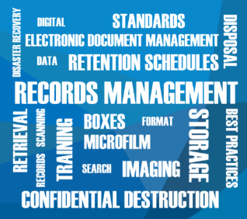
Overview
Records Management Introduction
Defining Records
Retention and Disposal Schedules
Preservation of Historical Records
Additional Resources
Best Practices for Recordkeeping
E-mail Management
Digital Imaging

Slide 3
Records Management Services (RMS)
Retention and Disposal Schedule development, review and approval
Recordkeeping system consulting
Imaging and document management services
Education and training
Records storage services
Notes:
3

Slide 4

Our Customers
Executive Branch
Legislative Branch
Judicial Branch
Local Governments

Slide 5
Records Analyst Services
Retention and Disposal Schedules - develop, review and approve
Provide records management training
Provide document management services
Provide recordkeeping system consulting
  Filing and storage (paper and electronic)
  Space management (paper and electronic)
  Electronic document management
  Digital imaging
  Micrographic systems

Slide 6
Records Management Principles
If the information is recorded it is a record
Public records are evidence of government activities
Destruction must be authorized by an approved Retention and Disposal Schedule
Records must remain accessible and usable for the entire retention period
Records that support a business process should be stored together
Every employee who creates, receives or maintains records is responsible for records retention
Notes:
Bullet #4 – storing records on a floppy disk that no longer fits in your computer is not complying with record retention requirements

Slide 7

Laws
Freedom of Information Act, Definitions
  M.C.L. 15.231-15.232
Management and Budget Act, Records Management
  M.C.L. 18.1284-1292
Historical Commission Act
  M.C.L. 399.1-10
Penal Code, Public Records
  M.C.L. 750.491
Note: The Michigan Compiled Laws are available online at http://www.legislature.mi.gov/
Notes:
FOIA: Defines public records and establishes exemptions from public disclosure. Note: records that are exempt from public disclosure are not exempt from record retention laws.
DMB Act: Establishes the RMS and defines its responsibilities. Defines approval process for retention schedules.
Historical Commission Act: Establishes that public records are the property of the people of Michigan. Declares that public records cannot be destroyed without the approval of the Historical Commission (responsibility delegated to the State Archivist).
Penal Code: Establishes misdemeanor penalties for destroying records without the authorization of an approved Retention and Disposal Schedule.

Slide 8

What is a Record?

Slide 9


Not All Records Are Equal…
Records we keep
Official Records
Records we don’t keep
Transitory Records
Non-record Materials
Personal Records

Slide 10
Official Records
Recorded information that is “prepared, owned, used, in the possession of, or retained by an agency in the performance of an official function.”
Source: Michigan’s Freedom of Information Act (FOIA)

Slide 11
Records You Need to Keep
Document how you fulfill your job duties
Document the functions of your agency
Document the tasks for which you are the designated recordkeeper

Slide 12
Official Records
Retention is governed by Retention and Disposal Schedules
Examples:
  Correspondence with general public, customers/clients, other government employees
  Completed applications
  Data
  Photographic evidence
  Reports of findings or activities
  Work calendars

Slide 13
Examples of Official Records
TO: Joe
FROM: Jim
SUBJECT: Contract
Please change the fourth paragraph in contract #10775 to read, “payment must be received within 30 days”, removing the phrase “60 days.”
TO: Bob
FROM: Carol, Personnel Director
SUBJECT: Reallocation
After further review, it is our decision that there is not sufficient justification to approve the reallocation for Susan’s position, based upon the fact that . . .
TO: Vendor
FROM: Lisa
SUBJECT: Contract
Thank you for your question. The intent is to guarantee unit prices to all state agencies and to provide a mechanism to easily obtain imaging services.
TO: Mark
FROM: John
SUBJECT: Appointment
This is your official notification of your appointment to the Taxation Committee. Your responsibilities include . . .

Slide 14
Creating Official Records with Personal Resources
Government business conducted using personal resources creates public records
  Personal e-mail account
  Social media tools (such as Facebook or Twitter)
  Personal cell phones
  Home computer
Subject to Retention and Disposal Schedules, as well as FOIA or litigation

Slide 15
Transitory Records
Records relating to agency activities that have temporary value and do not need to be retained once their intended purpose has been fulfilled.
Source: General Schedule 5.00

Slide 16
Transitory Records
GS 5.00: can be disposed of when activity is completed
Examples:
  Requests or reminders to do a routine task
  Simple inquiries about policies, office location and hours, etc.
  Information that is published somewhere, like the internet or a procedure manual
  Temporary documents that are replaced by other records that serve as evidence of the activity

Slide 17
Examples of Transitory Records
TO: Staff
FROM: Janet
SUBJECT: staff meetings
The staff meetings will be held on Tuesday mornings from now on instead of Thursday afternoons.
TO: Marilyn
FROM: Doug
SUBJECT: supplies
I noticed that there are no more blue ink pens in the supply cabinet. Can you please order more? Thanks.
TO: Doug
FROM: Becky
SUBJECT: Retention Schedule
Would you please e-mail me a copy of the schedule for Administrative Services?
TO: Debbie
FROM: Jim
SUBJECT: training
You have my approval to attend the seminar “Buying over the Internet.” Please complete your registration form within the next two weeks.

Slide 18
Non-records
Recorded information in the possession of an agency that is not needed to document the performance of an official function.
Source: General Schedule #1

Slide 19
Non-records
GS #1: can be disposed of when they are no longer needed for reference purposes
Examples:
  Publications received from outside sources
  Mass mailings, notices, flyers, advertisements, spam, junk mail
  Drafts that are replaced by new or final versions
  Duplicates
    Agencies can decide which format to use for retaining their records, if records exist in multiple formats
    If multiple offices possess the same record, they should communicate with each other about who is responsible for record retention

Slide 20
Examples of Non-records
TO: Jim
FROM: Marilyn
CC: Brice
SUBJECT: Contract
For your information, the contract has been mailed to Purchasing.
TO: Debbie
FROM: ARMA
SUBJECT: Books
The Association of Records Managers and Administrators has four new books for sale regarding e-discovery. They are . . .
TO: DMB
FROM: Susan
SUBJECT: Give Blood!
The American Red Cross Blood Drive will be held in Constitution Hall on November 20.
TO: Dave
FROM: Karen
SUBJECT: brochure
The attached Word document is a draft for your review. Please let me know if you have any comments. Thanks.

Slide 21
Personal Records
Records that document non-government business or activities.

Slide 22
Personal Records
Document your personal life
  Employee benefits
  Personal financial accounts
  Social events with co-workers and friends, etc.
  Personal purchases and shopping
Store personal records so they are physically separated from government records
Personal records should not be created and stored using government resources

Slide 23
Examples of Personal Records
TO: Sandy
FROM: Debbie
SUBJECT: Good luck!
Congratulations on your new job! It has been great working with you these past three years. Keep in touch!
TO: Jane Smith
FROM: John Smith
SUBJECT: late
Honey. My meeting is running later than expected. Please save dinner for me. Thanks.
TO: All Division Employees
FROM: Bob Jones, Director
SUBJECT: holiday
This year’s annual holiday buffet will be held on December 22 at noon in the conference room. Please remember to sign-up to bring a dish to pass.
TO: Fairlane Building Employees
FROM: Phyllis
SUBJECT: car
FYI. I noticed that a blue Oldsmobile in the parking lot with the license plate XYZ 123 has its lights on.

Slide 24
Retention and Disposal Schedules
Foundation of Records Management

Slide 25
Retention and Disposal Schedules
List records created and maintained by an agency
Define the retention periods for records
Provide the only legal authorization for destruction
Cover all records, in all formats
Should reflect current organization structure and business processes
Notes:
Misconceptions:
--Only records stored at the RC need to be listed on schedules
--If a record is not listed on a schedule, the agency can decide for itself how long to keep it
--Electronic records do not need to be listed on schedules
Schedules provide the ONLY legal authorization to destroy records. Records not listed cannot be destroyed.

Slide 26
Schedule Approval Process
Approved schedules are legal documents
Schedules are approved by:
  Agency representative
  Records Management Services
  Archives of Michigan
  State Administrative Board

Slide 27
Determining Retention Periods
Keep records as long as they have:
  Operational/Administrative Value
  Fiscal Value
  Legal Value
  Historical/Archival Value
Destroy records when their value ceases to exist

Slide 28
Types of Retention and Disposal Schedules
General Schedules
Agency-Specific Schedules

Slide 29
General Schedules
Cover records that are common to a particular function or type of agency
Records not listed on a general schedule must be listed on an agency-specific schedule
Do not mandate that records be created
Retention periods are minimums
Applies regardless of the format of the record (paper, microfilm, electronic, etc.)
Published on RMS website

Slide 30
General Schedules - Local
GS #1: Nonrecord Material Defined
GS #2: Public Schools
GS #3: County Registers of Deeds
GS #6: County Clerks
GS #7: Local Health Departments
GS #8: Cities and Villages
GS #9: County Roads Commissions
GS #10: Townships
GS #11: Local Law Enforcement
GS #16: Trial Courts
GS #17: Public Libraries
GS #18: Fire/Ambulance Departments
GS #19: Prosecuting Attorneys
GS #20: Community Mental Health Services

Slide 31
General Schedules - Local
GS #21: County Veterans Affairs
GS #22: Veterans Trust Fund
GS #23: Elections Records
GS #24: City and Village Clerks
GS #25: Township Clerks
GS #26: Local Government Human Resources
GS #27: County Treasurers
GS #28: City and Village Treasurers
GS #29: Township Treasurers
GS #30: Local Government Information Technology
GS #31: Local Government Financial Records
GS #32: Local Government Parks and Recreation Departments
GS #34: Local 9-1-1 Call Centers
GS #36: Drain and Water Resources Commissioners

Slide 32
Agency-Specific Schedules
Cover records that are unique to the agency
Cover records not listed on general schedules
Specific schedules always override general schedules when records are listed on both
Retention periods are absolute minimums and maximums
May identify the format of a record

Slide 33
Agency-Specific Schedules
Local Government
  Must develop their own and submit to RMS for approval
  Instructions and form available online at http://www.michigan.gov/dtmb/0,5552,7-150-9141_21738_31548-96228--,00.html

Slide 34
Why Follow a Retention Schedule?
Risks associated with keeping records too long
  Wastes space
  Harder to find records you need
  Records must be reviewed for FOIA and litigation
Risks associated with destroying records too soon
  Violation of Michigan law
  Exposes agency to liability if the records are requested via FOIA or litigation
Avoid random record purging by establishing a routine within the normal course of business for destroying records

Slide 35
Freedom of Information Act (FOIA)
FOIA allows the public to request copies of government records
Immediately cease all destruction of relevant records when a request is received
Contact FOIA coordinator and information technology staff immediately
FOIA coordinator will determine what is released
If records are destroyed on a regular basis (in accordance with approved Retention and Disposal Schedules), they may no longer exist when a FOIA request is received
Notes:
Responding to FOIA is time consuming. Time spent is time lost for regular duties. FOIA fees are insufficient to cover the cost of responding to the request.

Slide 36
Litigation
Parties to a lawsuit can request records they consider to be relevant evidence to the case
Immediately cease all destruction of relevant records when litigation is anticipated
Contact litigation coordinator and information technology staff immediately
Department of Attorney General or Legal Counsel will determine what is released
If records are destroyed on a regular basis (in accordance with approved Retention and Disposal Schedules), they may no longer exist when a litigation hold notice is received
Notes:
Responding to time consuming is time consuming. Time spent is time lost for regular duties. Cost of finding and reviewing records is not recovered.

Slide 37
Preservation of Historical Records
Archives of Michigan
Department of Natural Resources

Slide 38
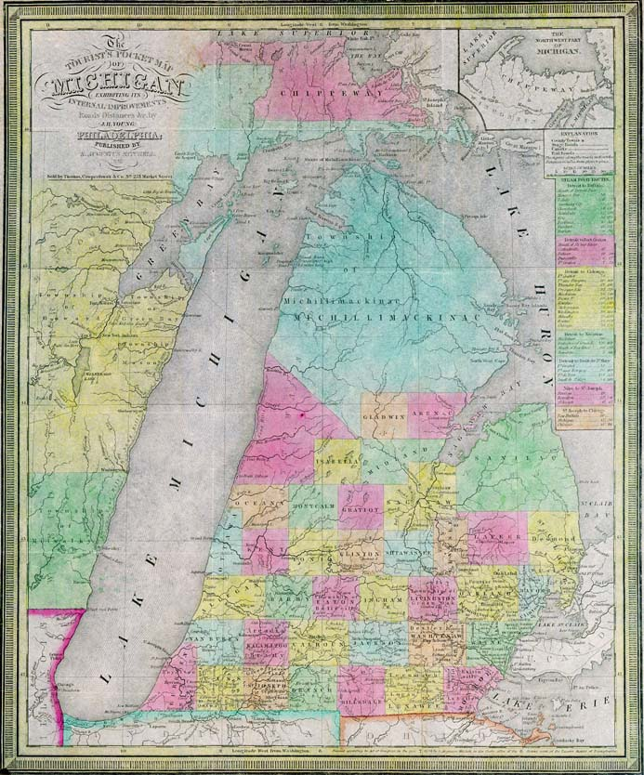

Slide 39
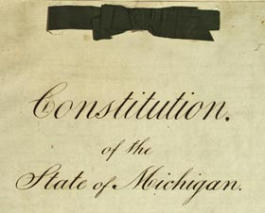
Mission
The Archives of Michigan identifies and permanently preserves public and private records that document significant government activities and historic eras/events.
Historically significant public records:
  Document how government operates
  Protect the rights of citizens
  Document society or important events
Michigan’s first constitution, 1835

Slide 40
Archival Records are Unique
Original (sometimes signed) recorded information
Evidence of activities, decision-making, progress and change
All formats: paper, electronic, audio, photographs, video, maps, microfilm, etc.
Less than 5% of public records have historical value
All agencies have potential to produce historically-significant records

Slide 41
Historical Records in Your Office
Schedules indicate which records should be transferred to the Archives of Michigan for permanent preservation
Historical records should be transferred to the Archives when they are no longer needed to support agency activities
Archives becomes the legal owner of the records in its custody

Slide 42
Examples of Archival Records
Meeting materials of public bodies (minutes, agendas)
Election results and precinct maps
Transportation maps and engineering drawings
Legislation development and analysis
Court case files
Naturalization records
Vital records (birth, death, marriage, divorce)
Photos and videos of important people, events, places, etc.

Slide 43
Transferring Records to the Archives
Local Government
Complete the Direct Records Transmittal (MH-85) form (available online) and send it to the Archives
Archives will contact the office to arrange the transfer

Slide 44
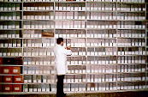
Benefits of the Archives
State-of-the-art storage conditions for preserving Michigan’s most valuable records
  Acid-free containers
  Environmentally-controlled storage area
  Fire and theft prevention
Records are preserved permanently
Records are made available to public

Slide 45

Using Records at the Archives
Public hours:
  Monday - Friday (1:00 - 5:00 p.m.)
  Saturday (10:00 a.m. - 4:00 p.m.)
  Closed state holidays
Records are open to the public
  Unless they are confidential
Records are used in a monitored reading room, and cannot leave the Archives’ facility
  Researchers must show picture ID
  Records can be reproduced
Questions answered by phone, e-mail, letter and on-site
  Compliance with FOIA timelines
  Some items available online via www.seekingmichigan.org

Slide 46

Archives of Michigan
702 West Kalamazoo Street
Lansing, Michigan 48913
(517) 373-3559 (select option #3 from the voice menu)
archives@michigan.gov
http://www.michigan.gov/archivesofmi/

Slide 47

Additional Resources

Slide 48
Records Management Training
Online Classes
  Managing Records is Important
  Basic Records Management
  How to Manage Records
  E-mail Management
  Imaging and Document Management
Online Guidance Topics
  E-mail
  Electronic Records
  Imaging
  Recordkeeping
  RM Manuals and Policies

Slide 49
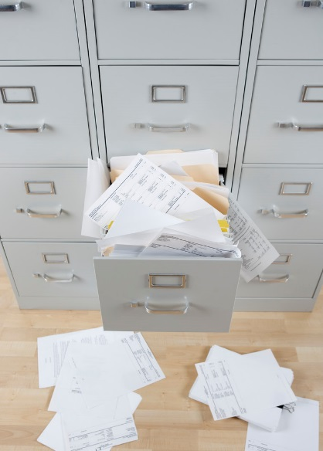
Best Practices for Recordkeeping

Slide 50
Do you have?
Disorganized records
Trouble finding records
Too much stuff

Slide 51
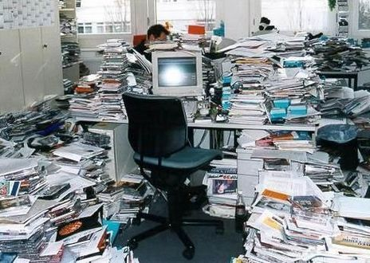
Does your office look like this?
Notes:
This is an actual state employee’s office. This employee’s office may have a great filing system. However, this employee is not using it, and is creating problems for everyone in the office.

Slide 52

Are these storage spaces a mess too?
E-mail account
Network shared drive
Individual network drive
Computer desktop

Slide 53

Common Recordkeeping Problems
No Collaboration Tools
Version Control
Litigation Holds
File Cleanup is Difficult
Accidental Deletion
Loose Security
Can’t Find Stuff
Duplicate Records
Stuff is Everywhere
Can’t Share Stuff
Retirements and Departures
FOIA Timelines
Email and Shared Drives Full
Disorganized Records
Notes:
These are common recordkeeping problems in 21st Century offices. **List some, not all**
Note that these problems are really prevalent on shared drives and e-mail accounts.

Slide 54
Did you know …
40% of records in offices have met their retention requirements and should be destroyed.
On average, 30% of records in offices need to be retained, but are not retrieved regularly, and should be stored off-site.
30% of records in offices are needed for on-site reference activities.
Notes:
In the records management profession it has been observed that the following percentages are accurate for every type of office.

Slide 55




What should we do with our records?
Keep
Store
Destroy
Notes:
Each of these options will be discussed in detail.

Slide 56
Keeping Records
Option #1

Slide 57

Retention and Disposal Schedules
Identify how long records must be kept
Provide the only legal authorization to destroy records
Cover all records, in all formats
Essential tool for managing records effectively and efficiently

Slide 58
Why do we keep records?
Document work
Document compliance with the law or rules
Document financial transactions
Document history of people, places and events

Slide 59
To Keep or Not to Keep
Keep
Don’t Keep
  You are the designated recordkeeper
  Document your job duties and responsibilities
  Document decisions and activities of your office
  Document guidance or services provided by your office
  Publications from outside sources (newsletters)
  Personal documents (family, personal finances, friends)
  Mass mailings (received)
  Drafts replaced by new versions
  Duplicate records
  Records that don’t document your job duties and responsibilities
  Reminders
  Spam, advertisements, junk mail
Notes:
To keep or not to keep, that is the question…

Slide 60

Who should keep records?
Creators/authors/senders
Recipients, if:
  The records document their job duties, and
  They do not have access to the creator’s records
Employees who are designated by their supervisor or a team to be responsible for recordkeeping
  Records are owned by the business process and need to be accessible
Notes:
**Give examples, especially e-mail. Emphasize that this applies to all formats. Records need to be accessible to all employees involved in a business process.

Slide 61
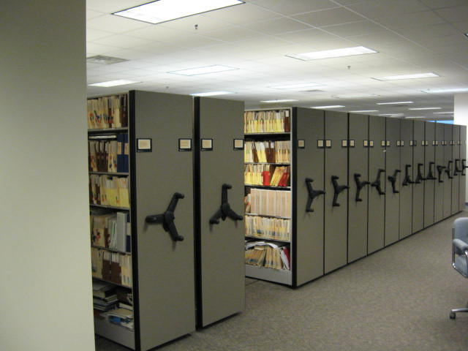

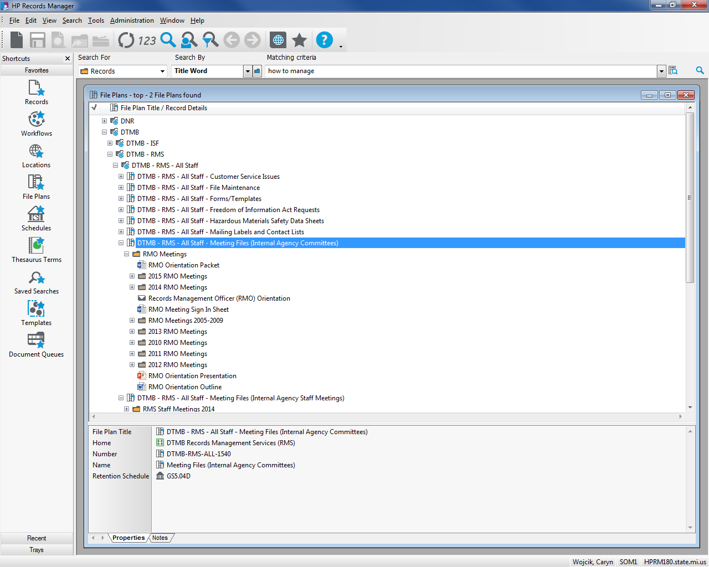
What is the purpose of a filing system?
Provide a secure location for storing records
Find records and information quickly and easily

Slide 62
Organizing Records
Organized records are easier to retrieve
Good organization is the responsibility of the user
Filing systems
  Should be easy to use
  Should be used consistently
  Exist in many formats and locations
RMS Guides
  Organizing Records
  Naming Records
Notes:
Bullet #1: When all of the records of a particular business process are kept together (centralized), staff only have to look one place to find the document they need to the answer to their question.
Decentralized storage makes the search and retrieval process more difficult, and possibly incomplete.
Bullet #2: File cabinets and computers do not require that records be organized.
Bullet #4: RMS just published 2 new online guides
** For example, do not use the folder title “reports” or “memos.”
**

Slide 63
Misfiling Statistics
Even a low misfiling rate can cause significant problems
For example, an office with 25 filing cabinets has approximately 200,000 documents
If ½ of 1% of the documents in those cabinets were misfiled, they would have 1000 documents that are filed incorrectly and cannot be found when they are needed
Notes:
**Example**

Slide 64

Misfiled and Disorganized Records
Cause frustration among employees and customers
Increase search time and cost
Result could be:
  Negative press coverage
  Agency fines
  Lost productivity

Slide 65
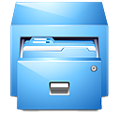


File Plans
Provide a tiered structure for organizing records
Make record storage and retrieval easier
Make record retention easier
File Plan Level | Content | Example
I | Record Series | Case Files
II | Folders | Case #123, ABC Company
III | Documents | Applications, Correspondence, etc.
Notes:
Level I: Compare the record series level to a file cabinet drawer, or a set of file cabinets dedicated to one type of record. This works in a computer directory structure as well. This level should match the Retention and Disposal Schedule.
Level II: This level is for the folders of each individual entity in the filing system. Naming conventions will promote consistency and help with retrieval. Retention is applied at this level, as the records age or close.
Level III: Document types must have the same retention period, so there is no weeding. You may create sub-folders or tabs in a folder, if it will make retrieval easier to separate different document types.

Slide 66
Tip: Re-organizing Filing Systems
New System: Design for day-forward implementation
  Develop business rules for consistently using the system
  Pick a start date for the new system
  Build new recordkeeping habits
Old System: Clean up is a separate project
  If possible, wait to implement clean up of the old system
  Developing new habits and business rules first will make clean up easier
Notes:
Before reading slide: Re-designing a filing system can feel overwhelming and intimidating. These tips may make it easier, and will help focus the implementation for long-term success.
After reading slide: This methodology may temporarily create two different systems for two different timeframes. Eventually, they will be merged.

Slide 67
Storing Records
Option #2

Slide 68

Storage Options
Cabinets
Shelving
Closets
Cubicles
Electronic storage
Off-site storage
Secret places nobody wants to admit exists…
Notes:
Electronic storage includes: shared drives, e-mail accounts, SharePoint and other EDM, cloud, hard drives, external devices, etc.

Slide 69

Nobody has unlimited funds or storage space
There is no “one size fits all” solution
Different records and processes have unique needs
Understand the total cost of ownership

Slide 70

Cost of Recordkeeping
Costs are different for each type of recordkeeping system
Cost factors include:
  Employees
  Volume of records
  Method of record creation and modification
  Storage and security
  Frequency of access, and type of access needed
Notes:
Each office’s resources will be different

Slide 71

Conduct a Needs Analysis
Define your problem
Analyze your current processes
  How/why records are created
  Storage (volume, location, security)
  Indexing
  Retrieval activity (who, how often, where)
  Workflow and record modifications
  Retention
Identify all potential solutions
Compare the costs of the solutions

Slide 72
Storage Options
Paper
Microfilm
Electronic Records
Notes:
These are the 3 primary formats that are used for storing records.

Slide 73
Paper Benefits
Easy to read
Easy to transport
Established filing rules
Satisfies long-term storage requirements
May be eligible for low-cost off-site storage

Slide 74

Paper Disadvantages
No disaster recovery
Single user/single location access
Expensive to duplicate
Easy to misfile or lose

Slide 75
When to Use Paper
Low retrieval activity
Low volume of records
Physical storage space is available (on-site or off-site)
Be aware that electronic storage is more expensive than paper storage, if the record was originally created in a paper format

Slide 76

Microfilm Benefits
Reduce space requirements (~ 98%)
Easy duplication and distribution
Preserves information (long-term stability)
Minimal system dependence
Security/protection (working and security copies)
Integrity of records
Improve filing and retrieval activity
Eliminate misfiles

Slide 77

Microfilm Disadvantages
Not user friendly
Central point of access
Single user access
Diminishing availability of film, readers, printers and scanners
Rising costs
Preservation requires proper environmental conditions

Slide 78

When to use Microfilm
Records
Will not be modified in future
Voluminous
Long retention period (> 50 years)
Low retrieval activity
Centralized access is sufficient

Slide 79

Electronic Records Benefits
Wide variety of tools
  Including digital images, e-mail, databases, word processed documents, spreadsheets, CAD, GIS, web pages, etc.
Eliminates physical storage
Easy to
  Analyze, manipulate, report
  Modify and duplicate
  Search, retrieve, transport and share

Slide 80

Electronic Records Disadvantages
Unlimited growth of electronic records makes them harder to manage
Electronic storage is not unlimited and free
Back-ups are required to protect against failure and corruption
Most offices do not implement retention consistently for paper and electronic records
Technology becomes obsolete quickly
Notes:
Storage Systems: e-mail, shared drives, SharePoint, databases, etc.
Costs include: storage, servers, backup, support staff time, upgrades, troubleshooting, security monitoring, etc.
Backups: Know the backup procedures for agency-owned systems, and test backup restoration
Implement Retention: risks of non-compliance
Obsolescence: Work with information technology staff to keep long-term records accessible (more than 10 years)

Slide 81

When to use Electronic Records
Records are frequently modified
Data manipulation, analysis and reporting
High retrieval activity
De-centralized access from multiple locations
Simultaneous multi-user access
Tracking for compliance

Slide 82

Destroying Records
Option #3

Slide 83
Why do employees hoard records?
Uncertainty: never know when you might need it
Productivity: more stuff demonstrates more effort
Fear: don’t want to be in trouble if it is gone
Technology: enables creation and storage of more
Volume: no time or motivation to sort through the stuff
Hidden: out of sight, out of mind
Accountability: no requirement to clean up

Slide 84

Applying Retention
RMS does not audit agencies to confirm compliance – it is the agency’s responsibility
Designate a records coordinator to ensure schedules are implemented
Applying retention saves space, saves money, improves retrieval of information, and reduces risk

Slide 85
Tip: Know Your Records
There are a lot of Retention and Disposal Schedules
  You don’t have to memorize all of them!
Most employees work with only a few records series on a regular basis
Learn the retention periods for the records you are responsible for regularly

Slide 86

Record Clean-up
Should be done regularly
Should be comprehensive
  Central office records and records maintained by individual employees
  All formats - paper and electronic
  All employees need to participate
Notes:
Regularly: annually, monthly, or as projects close
The first clean up event will be complicated. If it is repeated regularly, it will get easier.
Remember to clean up shared drives, individual network drives, hard drives, e-mail accounts, etc.

Slide 87

Develop New Habits
Clean up the low-hanging fruit right away, so it does not grow out of control
  Non-record Materials
    Drafts, duplicates, etc.
  Transitory Records
    Short-term value
  Personal Records
    Store at home
Notes:
--If your records are a mess, you may want to develop some new recordkeeping habits.
--Keep in mind, the longer you wait to clean up files, the harder it is to remember which records are important and which ones are not. Get rid of records you don’t need right away so they don’t clutter up your files.
--These 3 categories of records were discussed in the Basic Records Management class

Slide 88

Suspending Destruction
FOIA, Litigation, Audit
Immediately cease the destruction
Holds override retention schedules
Holds apply to all formats
Failure to cease the destruction could result in penalties

Slide 89

Implement Retention Regularly
It’s time to get organized!
Plan a clean-up day.

Slide 90

Sorry…
We can’t clean your office for you.

Slide 91


Snack It & Pack It Day
Purpose
  Kick start record clean-up
  Initiate a routine clean-up habit
Step #1: get supervisor to endorse the initiative
Step #2: schedule the date
Step #3: contact RMS for tools to help
  Poster
  Orientation presentation
  Tip sheet (available online)

Slide 93

E-mail Management

Slide 94

Over 40 Years Worth of E-mail
E-mail was invented in October 1971
  Technology to support sending electronic messages between computers in different locations
E-mail use increased steadily over the past 20 years, and the trend will continue
Today, most employees cannot function effectively at work without e-mail

Slide 95

E-mail Retention Principles
Purpose of the e-mail system is to send and receive e-mail messages
E-mail system is not a record retention/storage tool
Official records should be stored in the official filing system for the business process

Slide 96
What is the Retention Period for E-mail?
There is not a single retention period for all e-mail
Retention period depends upon the message
If the message is related to:
  Contracts - keep as long as all other contract records
  Personnel - keep as long as all other personnel records

Slide 97

E-mail Challenges
Employees receive a lot of e-mail
Employees don't have spare time
Identifying messages to keep is not easy
E-mail system tools require user interaction
Notes:
Employees receive a lot of e-mail and many don't have time to organize their messages. They especially don't have the time to make record retention decisions for each individual message, or to go back and clean out older messages they no longer need. Identifying which messages need to be kept and which can be deleted is not easy. E-mail system tools are improving, but they require the knowledge of the user to manage messages. The e-mail system needs to work for you.

Slide 98

E-mail Challenges
E-mail accounts are only accessible to the user
E-mail accounts are closed when the employee leaves government
E-mail remains with the employee when they change jobs within the government
Notes:
E-mail is owned by the business unit, not the employee. However, the e-mail system gives possession of the messages to the individual user, not the office. The challenges caused by this configuration are:
E-mail accounts are only accessible to the user
E-mail accounts are closed when the employee leaves government employment, regardless of the record's retention period
E-mail related to former duties remain with the employee when they change jobs within the government, even though they may be needed by the former office
This is especially problematic when responding to FOIA and litigation.

Slide 99
Retaining Records
Do you need to keep the record to document your work? Is it evidence?
Is the conversation completed, or could additional records follow that you will want to retain?
Is this a record that your co-workers are receiving too? Are you responsible for retention or is someone else responsible?
Should this record be stored in a shared file? Do your co-workers need to access it when you are out of the office?

Slide 100
Who is Responsible for Retention?
Senders/authors: are the “person of record” and are responsible for retention
Recipients:
  May need the record to support their business functions
  If recipients do not share the author’s filing system, they may need to keep the record
  Groups: should designate someone to be responsible for retaining the record into a shared file to reduce duplication
  Do not retain records distributed for informational purposes only

Slide 101
Employee Responsibilities
Decide which messages to keep and which to destroy
Empty e-mail trash bins to purge deleted messages frequently
File the messages that are retained in the designated filing system for the business process
Identify which retention schedule mandates the message’s retention or authorizes its destruction
  Know the retention periods that apply to your job duties

Slide 102
Management Responsibilities
Ensure that Retention and Disposal Schedules are accurate and comprehensive
Adopt and distribute an e-mail retention policy for staff
Adopt and distribute an acceptable use/etiquette policy
Communicate with relevant employees, attorneys and information technology staff when a FOIA request is received or when litigation appears to be imminent

Slide 103
Policies
Model e-mail retention policy (fill-in-the-blank) is available from the RMS website
  Defines status of e-mail as records
  Responsibilities
  Storage options

Slide 104
Other Communications Tools
Instant/Text Messages, Voice Mail, Blogs, Social Media sites, RSS Feeds, etc.
  Same records management principles apply:
    If the communication is recorded it is a record
    Status about the communication as a public record depends up on the content
    Who should retain it depends upon responsibilities of sender/receiver
    Records supporting the same business process need to be stored together on media that will keep them accessible and usable for the entire retention period
    Records can be a liability or an asset
    Content created and stored on government resources is not private
    Resources not owned and managed by government could contain public records, and these records may become the subject of FOIA requests and litigation

Slide 105
E-mail is Not Private
Do not write something in an e-mail message that you do not want to see published in the newspaper or on television news reports.

Slide 106
E-mail Liabilities
Public officials and government employees have been caught using electronic messaging systems inappropriately, saying things they did not want to be public knowledge, or destroying electronic records illegally.
  Some have lost their jobs
  Some have had to pay hefty fines
  Some have gone to jail

Slide 107

You are Effectively Managing Your E-mail If…
Messages that are still in your e-mail account (inbox and sent mail):
  Have not been read yet, or
  Are related to tasks awaiting further action
Messages that are records are filed in the designated filing system
Messages that are transitory, duplicates and personal are deleted

Slide 108

E-mail Storage Options
No “one size fits all” solution
  Each option has pros and cons
Options:
  Keep messages in the active e-mail account
  Print and file messages in a hard copy system – destroy electronic copy
    Permitted as long as there is no active FOIA or litigation activity
  Save the messages on a network drive
    Permitted as long as there is no active FOIA or litigation activity
  Move messages to the e-mail system’s archive
  File messages in a document management system

Slide 109
Tips for Cleaning E-mail Accounts
Don’t Wait: Make retention decisions right away
  The longer you wait to clean out messages, the harder it will be to remember which messages are important
  Know which records you are responsible for filing to support your job duties, and their retention period
Message Strings: Retain only the last message in the conversation, if it includes the content (including attachments) of all the previous messages
Delete the Easy Stuff: Mass mailings, advertisements, etc.
Don’t Keep Duplicates: Avoid confusion about drafts and versions
Calendars: Retain appointments for 2 years
Trash: Empty deleted items and junk mail daily

Slide 110
Clean-up Strategy
Day-forward first
  Pick a start date for managing new e-mail
  Move all older e-mail to a folder titled with a date range (pre-2016)
  Consistently manage new messages as they are sent and received
  Adopt new recordkeeping habits
Don’t worry about the old stuff
  Wait 6-12 months to clean up of the old e-mail
  New habits will make clean up easier when you are ready
Notes:
Before reading slide: Re-designing a filing system can feel overwhelming and intimidating. These tips may make it easier, and will help focus the implementation for long-term success.
After reading slide: This methodology may temporarily create two different systems for two different timeframes. Eventually, they will be merged.

Slide 111

E-mail Management
Online training, available on demand
See RMS website, Training tab
Takes about 30 minutes
Notes:
RMS gets a lot of questions about e-mail management. This class is designed to answer those questions. You can take it online at any time. RMS has additional online tools about e-mail.

Slide 112
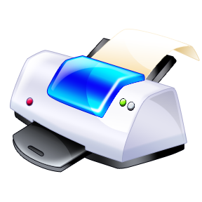
Digital Imaging

Slide 113
Michigan Law
Records Reproduction Act (MCL 24.401 - 24.406)
“a record reproduced under this act shall have the same force and effect as a true paper copy of a record.”
Reproductions under the act “shall have the same force and effect as an original for all legal purposes and is admissible in court, administrative proceedings, and elsewhere as evidence in the same manner as an original.”

Slide 114
Records Reproduction Act
Requires that certain technical standards be promulgated to regulate quality
  Microfilm
  Digital imaging
  Digital migration
Reproductions cannot be used as official records if they were not created according to SOM standards

Slide 115
Imaging and Microfilming Standards
Standards were promulgated August 2005:
  Conversion of Paper or Microfilm to Digital Images
  Conversion of Paper to Microfilm
  Conversion of Digital Images to Microfilm
“Best Practice” documents explain how and why these technologies should be used
Available on RMS website

Slide 116
State of Michigan Contracts
Microfilm conversion (from paper or images)
Imaging conversion (from paper or microfilm)
Microfilm storage
Microfilm inspection and repair

Slide 117
Services Provided
Budget Quote
Full Review and Analysis
Statement of Work (SOW) Development
Products and Services
  Images
Notes:
Customer needs to establish a safe repository for storing and retrieving the images that are delivered

Slide 118
SOM Contract Benefits
Contracts were competitively bid
  Government agencies do not need to re-bid to procure the services
Billing is handled by SOM
SOM monitors vendor compliance and resolves issues
SOM develops the SOW to help agencies get the services they need, instead what the vendor wants to sell
  SOW defines agency and vendor responsibilities for the scanning project

Slide 119
Contact Information
Graphic Sciences, Inc.
Greg Colton, President
colton@gsiinc.com
800-397-6620
(mention the SOM contract)

Slide 120

We can help!
Records Management Services
3400 N. Grand River Ave.
Lansing, Michigan 48909
(517) 335-9132
http://www.michigan.gov/recordsmanagement/
Notes:
If you have any questions, now is a great time to ask…

